Slide 1
Recursion in C

Slide 2
Consider a function
#include <stdio.h> void callMe(){
Output
Hello World
printf(“Hello World\n”);
}
void main(){
callMe();
}

Slide 3
Consider a function
#include <stdio.h> void callMe(){
Output
Hello World Hello World Hello World
….
…
printf(“Hello World\n”);
callMe();
}
void main(){
callMe();
}

Slide 4

Consider a function
#include <stdio.h> void callMe(){
Output
Hello World Hello World Hello World
….
…
printf(“Hello World\n”); callMe();
}
void main(){
callMe();
}
Hello World
Hello World
main
callMe
callMe

Slide 5
What is Recursion?
When a function calls itself, the phenomenon is called RECURSION.
Self-calling functions are often called recursive function.
For successful recursion the self calling must be stopped.

Slide 6
How to stop?
#include <stdio.h> void callMe(int n){
if(n == 0) return;
printf(“Hello World\n”);
callMe(n-1);
}
void main(){
callMe(2);
}
Output
Hello World Hello World
Hello World
Hello World
n=2
n=1
n=0
main
callMe
callMe
callMe

Slide 7
Another example
#include <stdio.h> void callMe(int n){
if(n == 0) return; printf(“Hello World\n”); callMe(n-1);
printf(“Biday Prithibi\n”);
}
void main(){
callMe(2);
}
Output
Hello World Hello World Biday Prithibi Biday Prithibi
Hello World Hello World
n=2
n=1
n=0
main
callMe callMe
callMe
Biday Prithibi
Biday Prithibi

Slide 8
Printing numbers (downward)
#include <stdio.h> void callMe(int n){
if(n == 0) return;
printf(“%d\n”,n);
callMe(n-1);
}
void main(){
callMe(2);
}
Output
 | 2
 | 1
2
1
n=2
n=1
n=0
main
callMe
callMe
callMe

Slide 9
Printing numbers (upward)
#include <stdio.h> void callMe(int n){
if(n == 0) return;
callMe(n-1);
printf(“%d\n”,n);
}
void main(){
callMe(2);
}
Output
 | 1
 | 2
n=2
n=1
n=0
main
callMe
callMe
callMe
2
1

Slide 10
We did some analysis of recursion. Now we will see some problem solving using recursion.

Slide 11
Recursion main logic
Find Recursive Definition (RD) of the problem
Find Base case where we do not need any recursion
Put Base case inside if block and recursive part under else block.

Slide 12
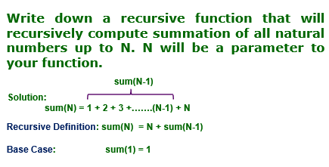
Problem 1

Slide 13
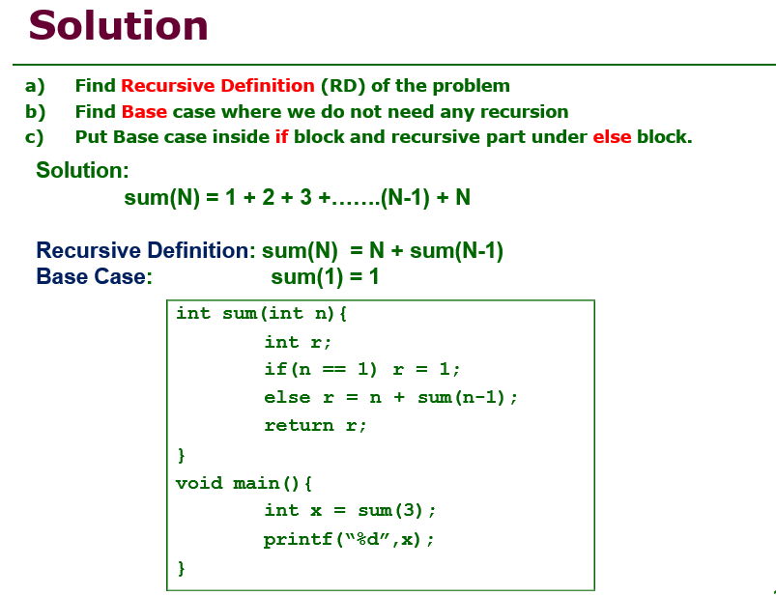

Slide 14
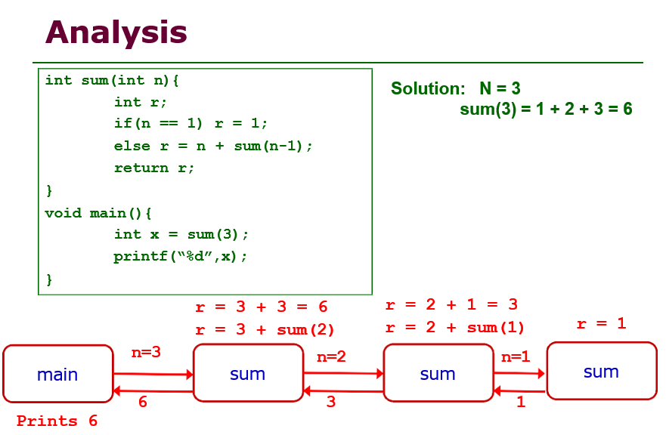

Slide 15
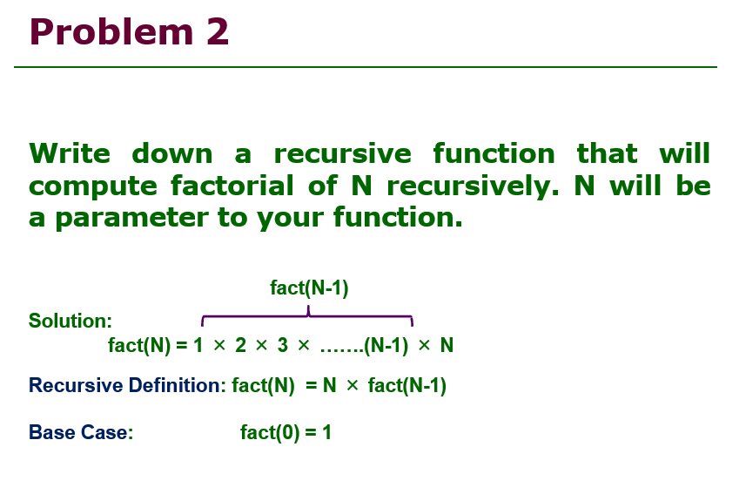

Slide 16
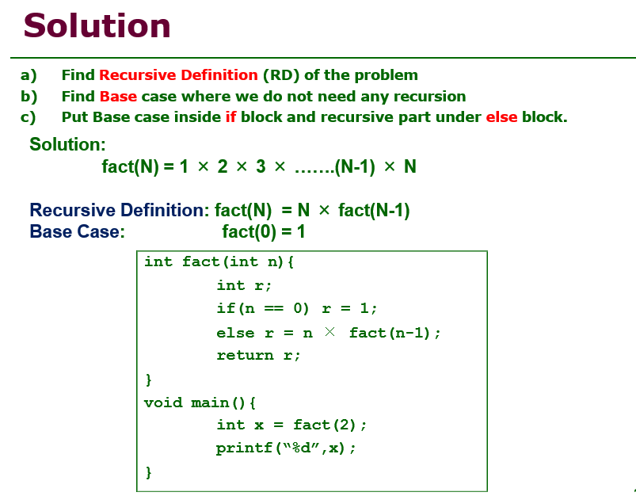

Slide 17
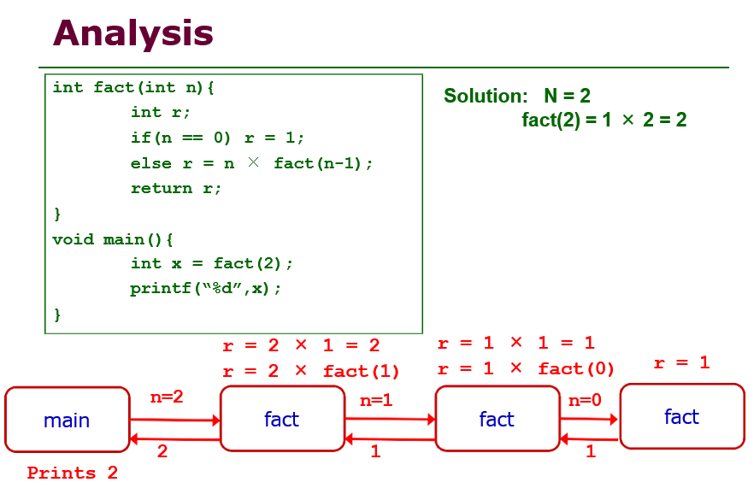

Slide 18
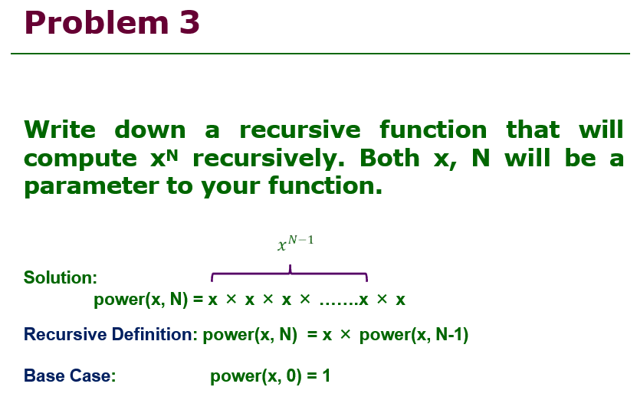

Slide 19
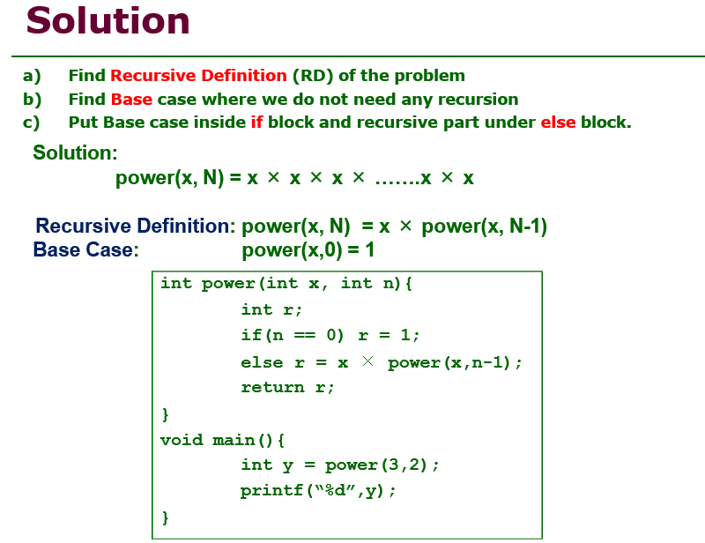

Slide 20
